Slide 1
Data Science: Big Data Management Systems & Tools
Module 4: Spark 1

Slide 2
Module 4 Summary
Spark for processing and performing analytics on massive datasets
Learning Outcomes
The advantages of Apache Spark over Hadoop
The high level architecture of Spark
The Spark API

Slide 3

Apache Spark 101
Apache Spark is a cluster computing platform designed to be fast and general purpose
Spark was initially built as a part of a PhD project at UC Berkeley by Matei Zaharia
Spark was designed overcome Hadoop's limitations such as speed, workload variety, singular language
Spark can run upto 100x faster than MR!
Spark can run on top of HDFS as a faster processing engine

Slide 4
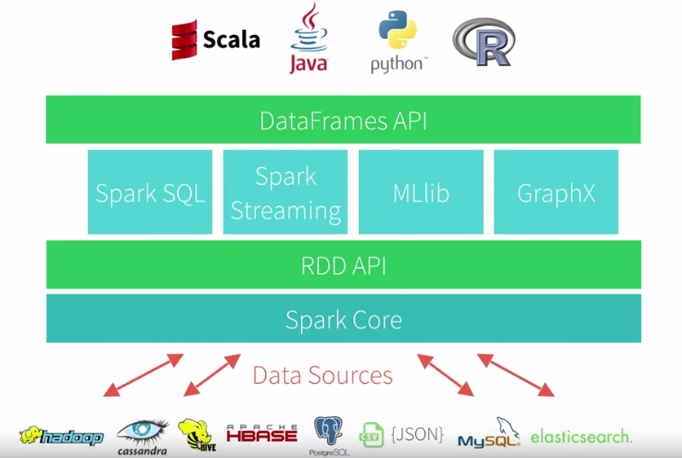
Apache Spark 101
At its core, Spark is a "computational engine” that is responsible for scheduling, distributing, and monitoring applications consisting of many computational tasks across many worker machines.

Slide 5
Apache Spark Components
Spark Core: contains the basic functionality of Spark, including components such task scheduling, memory management
Spark SQL: package for working with structured data. It allows querying data via SQL
Spark Streaming: Spark Streaming is a Spark component that enables processing of live streams of data.
MLlib: Spark comes with a library called MLlib that provides popular machine learning algorithms
GraphX: GraphX is a library for manipulating graphs (e.g. a social network’s friend graph) and performing graph-parallel computations.

Slide 6
Overcoming Hadoop
Speed
Spark is much faster than Hadoop MR, because of its ability to run multi-step computations in memory rather than always needing to save data to disk between tasks
Variety of workloads
Spark cover a range of distributed computational workloads that required several specialized computers and software before. The types of workloads include batch applications, iterative algorithms, interactive queries, and streaming
Working with multiple languages
Spark offers several simple APIs in Python, Java, Scala, R and SQL
Rich libraries
Spark provides a lot of rich built-in analytics capabilities through included libraries

Slide 7
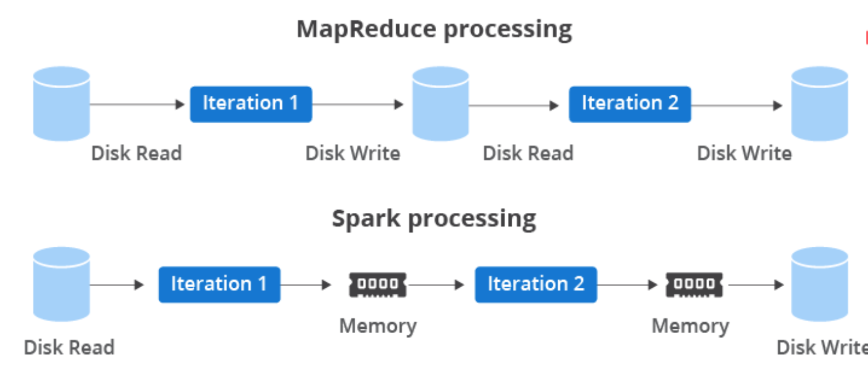
In memory process saves computation
Thinking of an iterative task like machine learning
It has a need to access the same data set over and over for processing
In-memory processing allows you to access the same data quickly
Writing/Reading to and from Disk is an expensive operation as it takes time to perform each operation.
Storing in memory, as opposed to writing to disk, means that accessing the information you need is a lot faster.
Note: In Machine Learning you have an algorithm that is executing 100s, 1000s or even millions of computations on the same input data set

Slide 8
Under the hood of Spark
Spark program needs the programmer to specify to Spark how to access the cluster. Spark uses this information to create a SparkContext object
SparkContext object then create a structure called a Resilient Distributed Dataset (RDD), which represents an immutable collection of elements that can be operated on in parallel.
As the RDD and actions are being created, Spark creates a Directed Acyclic Graph (DAG) where the vertices are processing steps and the arcs define the order of these operations to efficiently carry out parallel computation. This is similar to an "explain" plan in SQL.
Then you can interactively define transformations and actions which will extend the DAG, but the actual processing won't kick off until an action is specified.

Slide 9

Spark Architecture
SparkContext (SC) can connect to several types of cluster managers. Once connected, Spark acquires executors on nodes in the cluster, which are processes that run computations and store data for your application
SC then sends your application code to the executors.
Finally, the SC sends tasks (commands to run your application code) to the executors to run.
Each application gets its own executor processes, which has a benefit of isolation, but also means that you cannot share data across applications without writing it externally

Slide 10
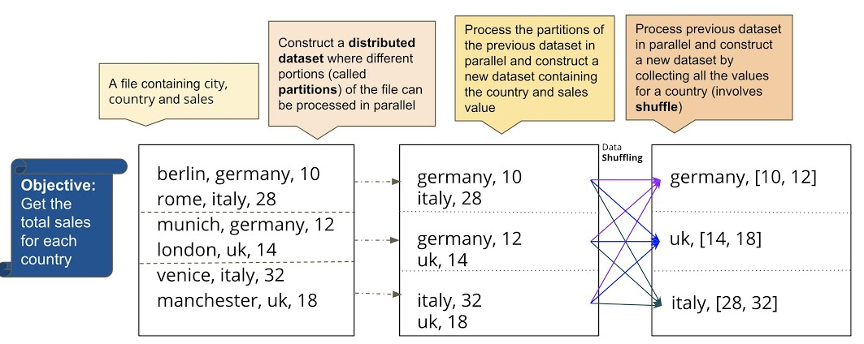
Spark Data Structure - RDD
Spark revolves around the concept of a Resilient Distributed Dataset (RDD)
RDDs are an immutable, fault-tolerant, compile type safe, collection of elements that can be operated on in parallel
RDDs are LAZY, where has no transformation execute until an action takes place
There are two ways to create RDDs:
parallelizing an existing collection (e.g an array or table of data) in your driver program,
or referencing a dataset in an external storage system
Resilient - RDD1 (T) RDD2 (T) RDD3
Immutable - Original RDD is unaltered
Compile type safe - Validate types during compile

Slide 11
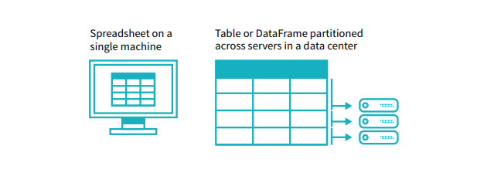
Spark Data Structure - Dataframes
After a few year, the concept of dataframes was born
Spark dataframes and RDD with a schema
This means the data is now in tabular form and can be queried using SQL
It’s easier to manipulate the data using the Dataframe API rather than the RDD
DataFrames can be constructed from a wide array of sources such as:
structured data files,
tables in Hive,
external databases,
or existing RDDs

Slide 12
Spark Data Structure - Dataset
A Dataset is a distributed collection of data that provides the benefits of RDDs (strong typing, ability to use powerful lambda functions) but is used with Dataframes (Spark SQL and can benefit from Spark SQL optimized execution engine)
A Dataset can be constructed from java virtual machine objects and then manipulated using functional transformations (map, flatMap, filter, etc.)

Slide 13
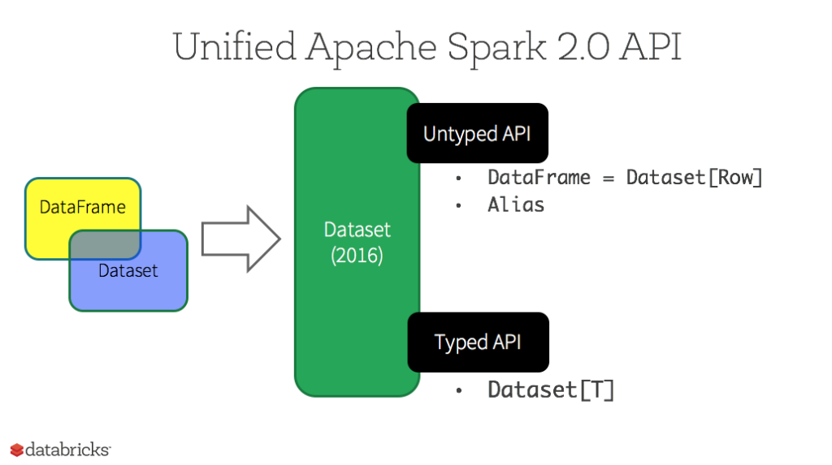
Spark 2.0 DataFrame merge to Dataset
In Spark 2.0, the DataFrame API has been merged with the Datasets API, thereby unifying the data processing capabilities across libraries
As a result, developers now have fewer concepts to learn, and can work with a single high-level and type-safe API called Dataset.

Slide 14
Pros and cons of each type of API
 | RDD | DataFrames & DataSets
Advantages | Full control of dataset | Strong type safety, Ease of readability
Disadvantages | Hard to optimize | Loss of low level control

Slide 15
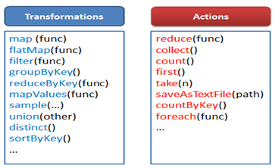
Spark transformation and actions
A transformation is every Spark operation that returns a DataFrame, Dataset, or an RDD
Actions are Spark RDD operations that give non-RDD values
Spark operation are lazy - they do not compute their results right away. Instead, they remember the transformations applied to some base dataset until an action is called

Slide 16
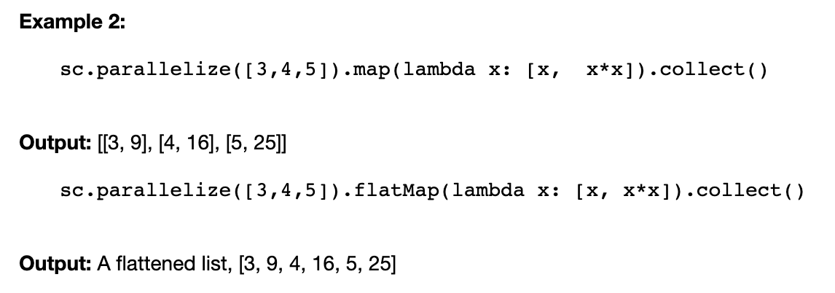
Map and flatMap
The map and flatMap transformations are similar, in the sense that they take a line from the input RDD and apply a function to it
The way they differ is that the function in map returns only one element, while the function in flatMap can return a list of elements (0 or more)

Slide 17
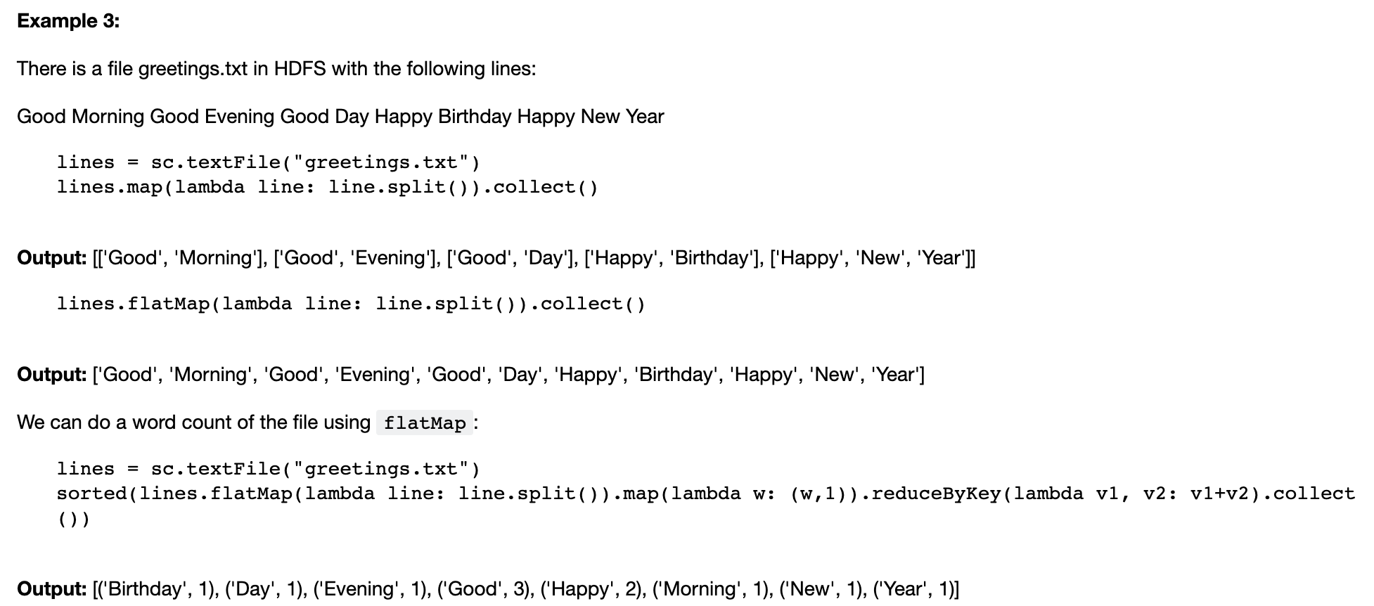
Example walkthrough

Slide 18


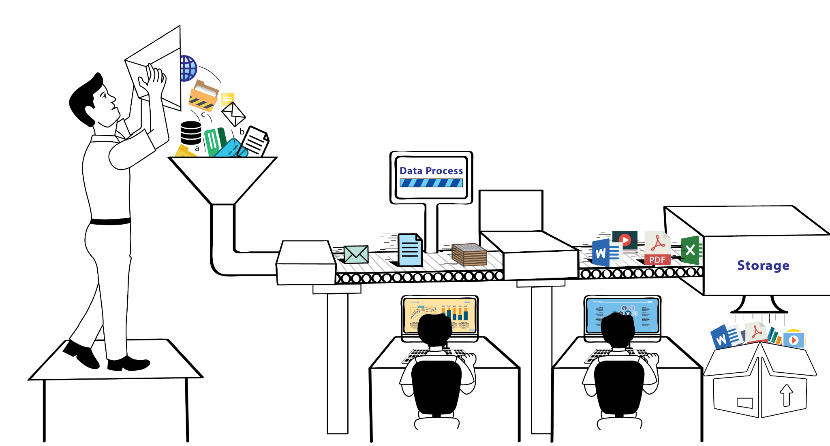
Why is this important?
Simplicity
Provides a simple, well-documented API for quickly interacting with data at scale
Speed
Can be 100x faster than its competitors for processing Big Data and has been clocked at processing 100TB+ of data in 23 minutes
Support
Supports a range of programming languages, integrations with storage systems and a multitude of data functions enabling an analytics toolbox for a variety of data users

